Slide 2
MMA841 Operations Management Inventory Management
Master of Management Analytics – Session 6
Geoff Pond
Notes:
An example of a title page with more specific program details in the title

Slide 3
Newsvendor Model with Reactive Capacity

Slide 4
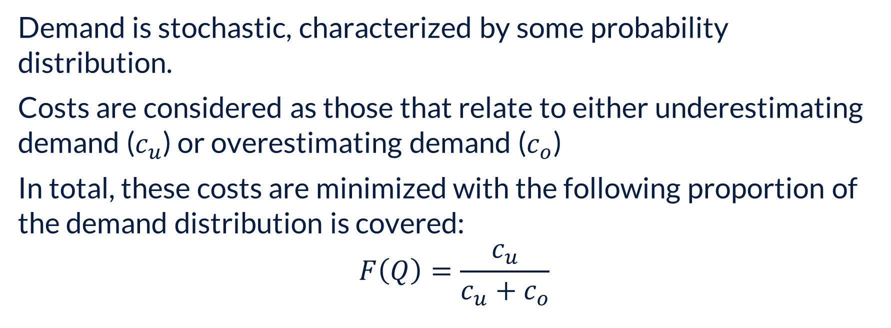
Newsvendor Model Recap….
Demand is stochastic, characterized by some probability distribution.
Costs are considered as those that relate to either underestimating demand ($c_{u}$) or overestimating demand ($c_{o}$)
In total, these costs are minimized with the following proportion of the demand distribution is covered:
$$F\left(Q\right)=\frac{c_{u}}{c_{u}+c_{o}}$$

Slide 5
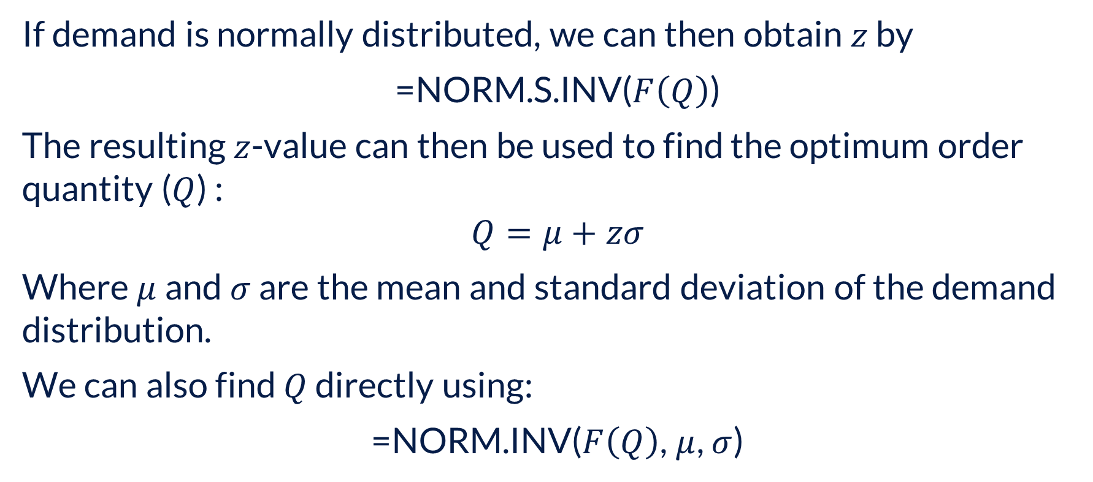
Newsvendor Model Recap….
If demand is normally distributed, we can then obtain $z$ by
=NORM.S.INV($F\left(Q\right)$)
The resulting $z$-value can then be used to find the optimum order quantity ($Q$) :
$$Q=μ+zσ$$
Where $μ$ and $σ$ are the mean and standard deviation of the demand distribution.
We can also find $Q$ directly using:
=NORM.INV($F\left(Q\right)$, $μ$, $σ$)

Slide 6
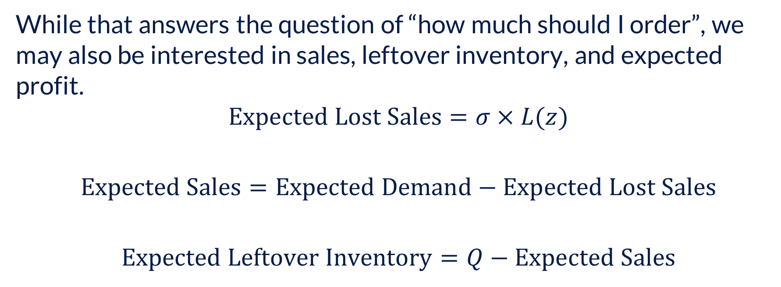
Newsvendor Model Recap….
While that answers the question of “how much should I order”, we may also be interested in sales, leftover inventory, and expected profit.
$$\text{Expected} \text{Lost} \text{Sales}=σ×L(z)$$
$$\text{Expected} \text{Sales}=\text{Expected} \text{Demand}−\text{Expected} \text{Lost} \text{Sales}$$
$$\text{Expected} \text{Leftover} \text{Inventory}=Q−\text{Expected} \text{Sales}$$

Slide 7
Newsvendor Model Recap….
As illustrated to here, the Newsvendor model relates to a single demand period with only a single opportunity to obtain sufficient inventory to sustain operations throughout the demand period.
That changes when we add the possibility for reactive capacity…

Slide 8
Newsvendor Model with Reactive Capacity
As earlier, we start with the opportunity to purchase inventory in advance of the demand period. BUT now (with reactive capacity), we can make an additional purchase inside the demand period.
From our perspective, we will be:
Deciding how much inventory should be purchased in advance of the demand period; and
Estimating how much additional inventory we will likely purchase on a second order inside the demand period

Slide 9
Newsvendor Model with Reactive Capacity
The kicker is that we will seldom (i.e., “never”) obtain the same purchase cost when issuing an urgent request inside the demand period, when compared to the cheaper costs associated with buying well in advance.

Slide 10
Newsvendor Model with Reactive Capacity
PECO has an idea to reduce the consumption of electricity by residential users. It normally charges customers $0.11 per kWh. With a new plan, the customer pays $0.10 per kWh for the first 800 kWhs of the month, $0.15 per kWh for the next 200 kWhs (i.e., kWhs 800 through 1000) and $0.35 per kWh for all additional kWhs (i.e., all kWhs above 1000). If a household's monthly usage is normally distributed with a mean of 900 and a standard deviation of 400, what would be the household's average monthly bill under this new plan?

Slide 11
Newsvendor Model with Reactive Capacity

Slide 12
Newsvendor Model with Reactive Capacity

Slide 13
The Beer Game

Slide 14
The Beer Game
The beer game is an educational simulation created decades ago that remains popular. Each player represents one of the echelons of the supply chain: retailer – wholesaler – distributor – brewery. For you, it will be one “team” per echelon and you will collectively make decisions for volume ordering each week.
Step 1: One person from your team create an account at https://games.fathomd.com/

Slide 15
The Beer Game
Step 2: After creating your account and logging in using that account, click the button labelled “Join New Game Session”
Step 3: Use the code tyx3
Step 4: Wait for the game to start….

Slide 16
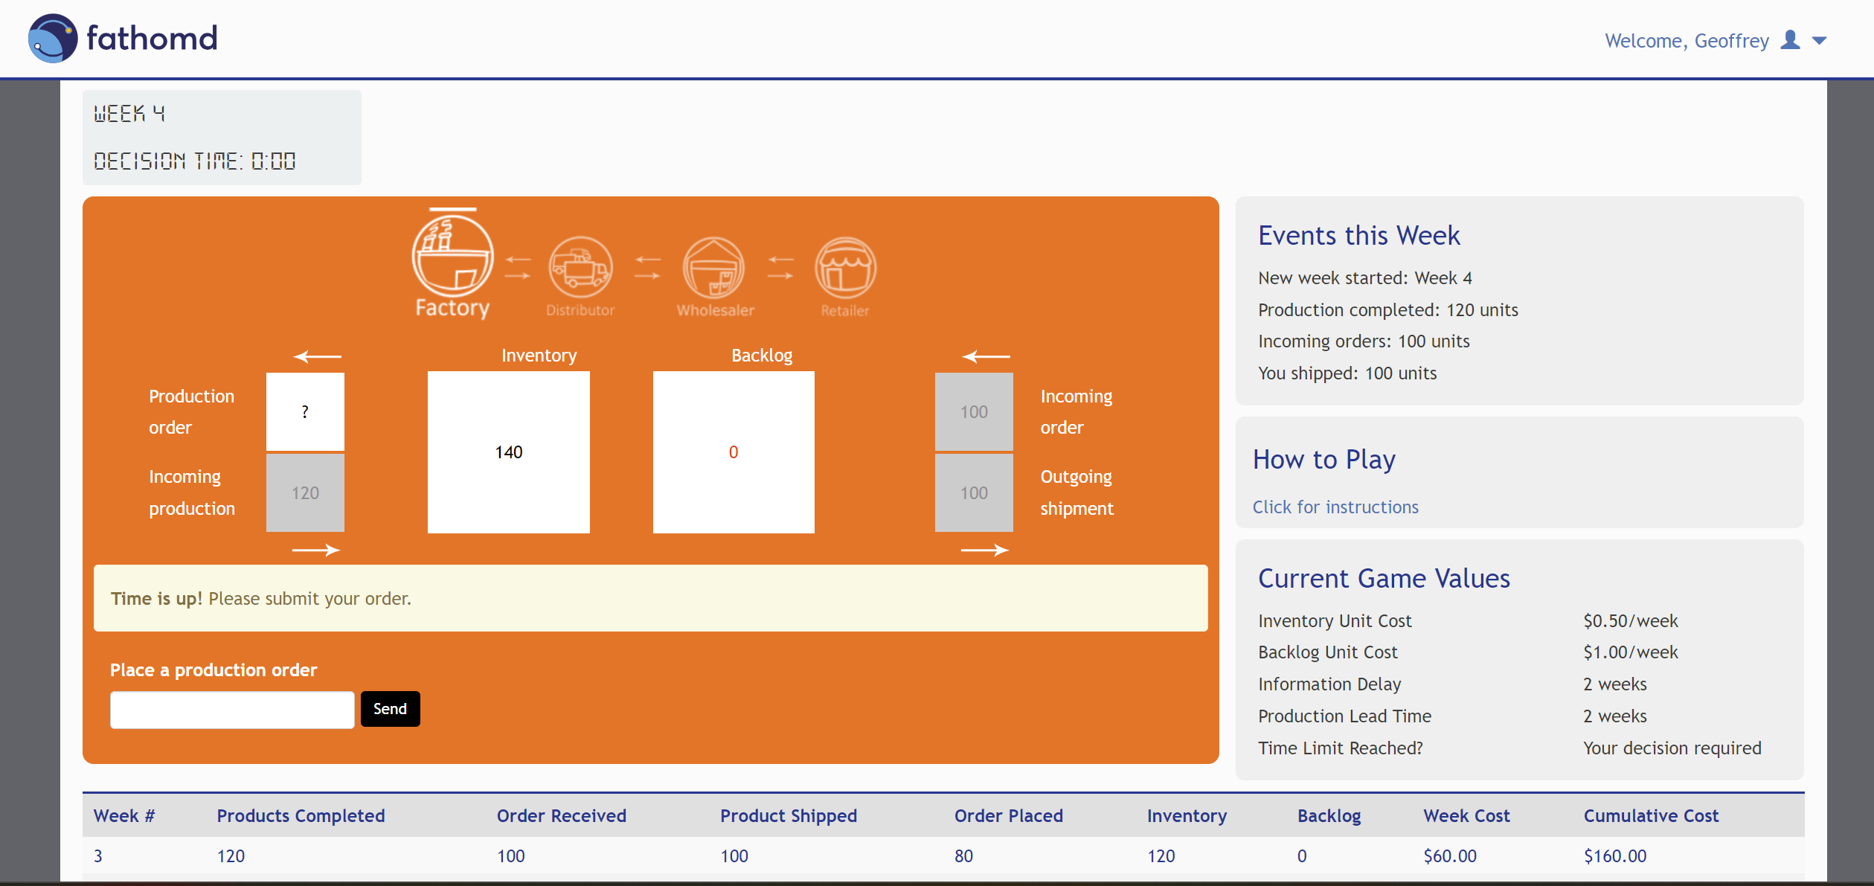
The Beer Game
The game interface is fairly intuitive…

Slide 17
The Beer Game
While a relatively simple simulation, you may quickly lose track of what is happening in other echelons. This box will contain select information visible to your echelon.
The game is relatively intuitive but explicit instructions are available her.
Take note of these values as they should be informing your ordering policy.

Slide 18
The Beer Game
The time remaining before an ordering decision is required can be viewed here.
Each week, input your order volume here and press “Send”

Slide 19
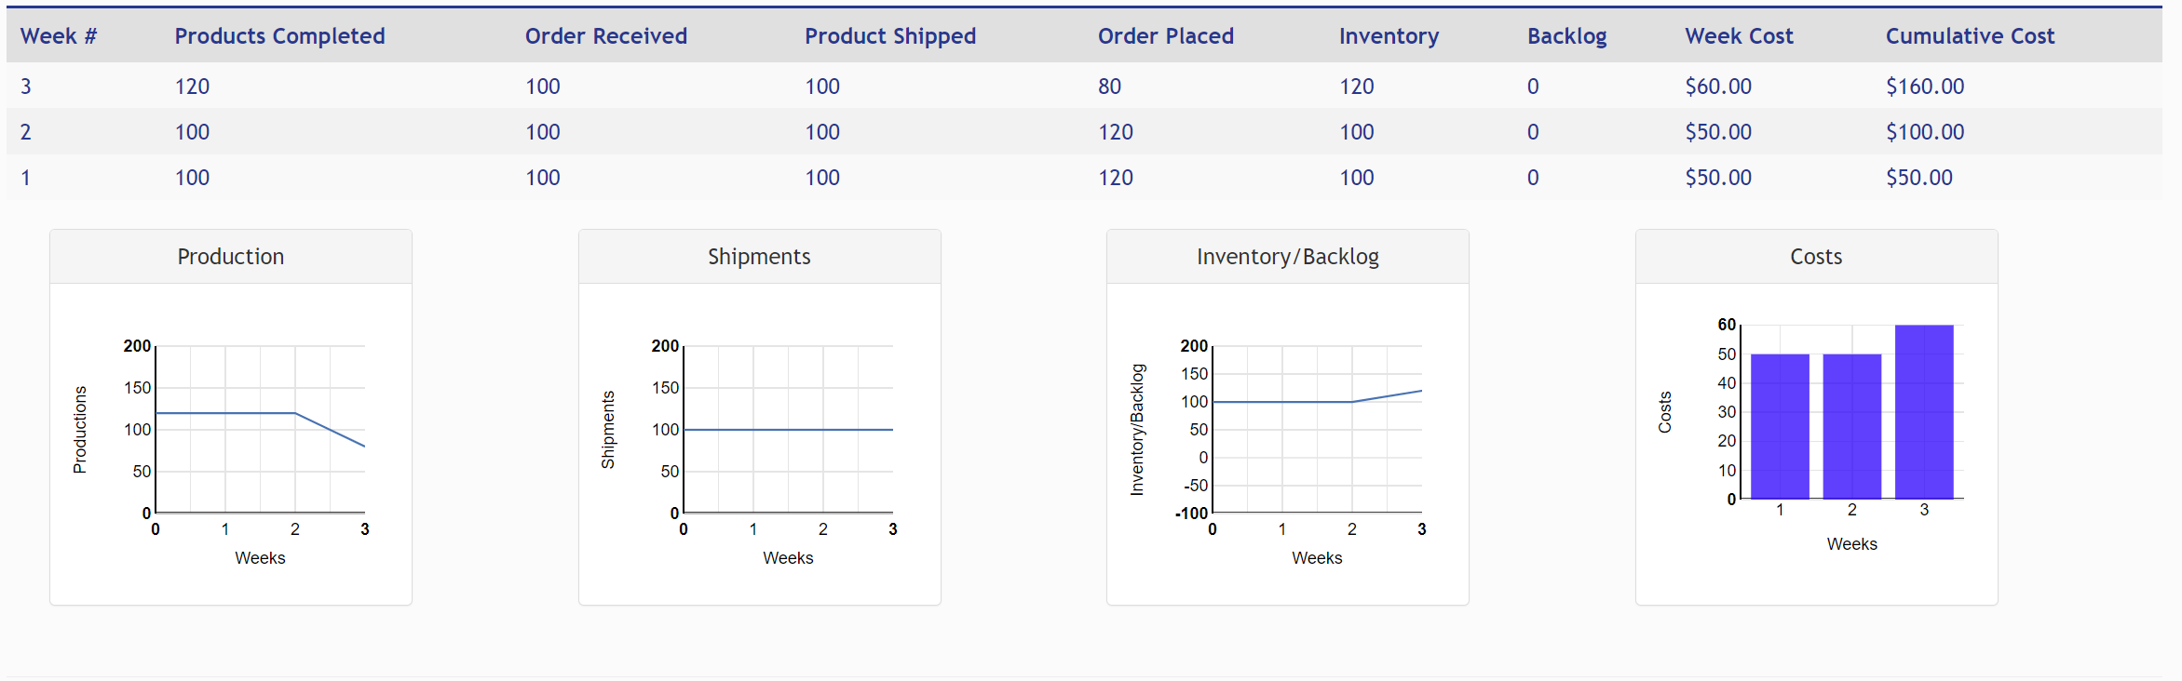
The Beer Game
As the weeks go on, you can track your inventory accumulation or backlog, and associated costs at the bottom of the window. You may have to scroll down to see it.

Slide 20
Order-Up-to-Level (OUL) with Periodic Review

Slide 21
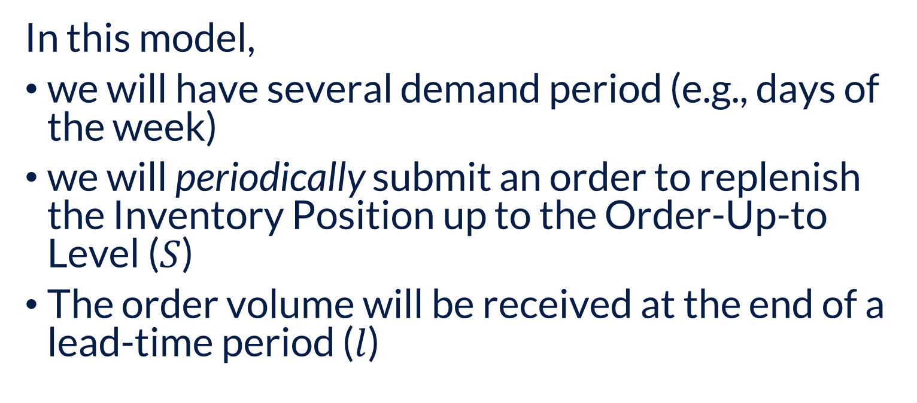
Order-Up-To Model
In this model,
we will have several demand period (e.g., days of the week)
we will periodically submit an order to replenish the Inventory Position up to the Order-Up-to Level ($S$)
The order volume will be received at the end of a lead-time period ($l$)

Slide 22


Order-Up-To Model
$$\text{OUL} (S)$$
$$l$$
Time
The orange line represents Inventory Level, formally defined as:
$$\text{Inventory} \text{Level}=\text{On}\text{−}\text{hand} \text{Inventory}−\text{Back} \text{Order} \text{Qty}$$

Slide 23


Order-Up-To Model
$$\text{OUL} (S)$$
$$l$$
Time
The blue line represents Inventory Position, formally defined as:
$$\text{Inventory} \text{Position}=\text{On}\text{−}\text{order} \text{Inventory}+\text{Inventory} \text{Level}$$

Slide 24
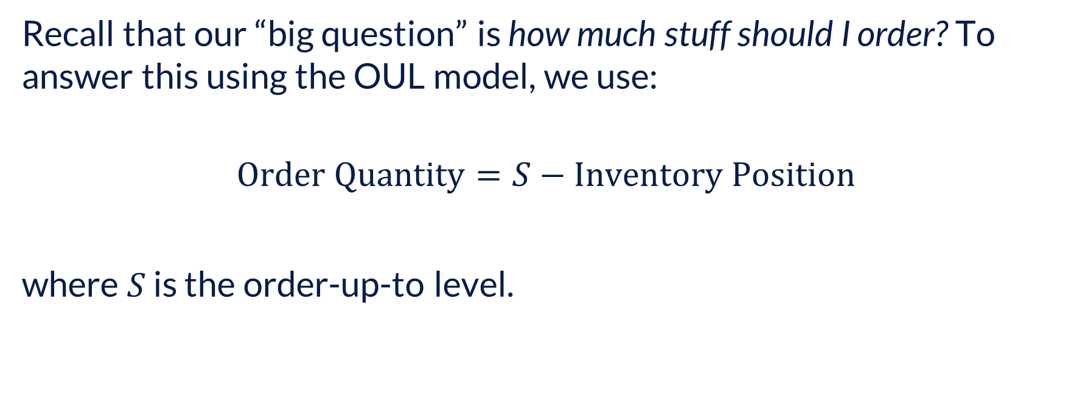
Order-Up-To Model
Recall that our “big question” is how much stuff should I order? To answer this using the OUL model, we use:
$$\text{Order} \text{Quantity}=S−\text{Inventory} \text{Position}$$
where $S$ is the order-up-to level.

Slide 25
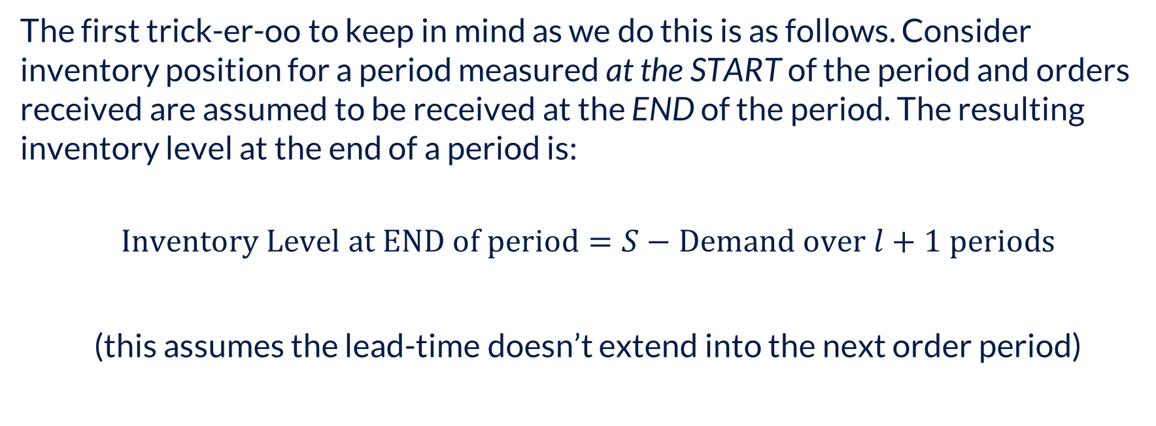
Order-Up-To Model – Trick-er-oo #1
The first trick-er-oo to keep in mind as we do this is as follows. Consider inventory position for a period measured at the START of the period and orders received are assumed to be received at the END of the period. The resulting inventory level at the end of a period is:
$$\text{Inventory} \text{Level} \text{at} \text{END} \text{of} \text{period}=S−\text{Demand} \text{over} l+1 \text{periods}$$
(this assumes the lead-time doesn’t extend into the next order period)

Slide 26
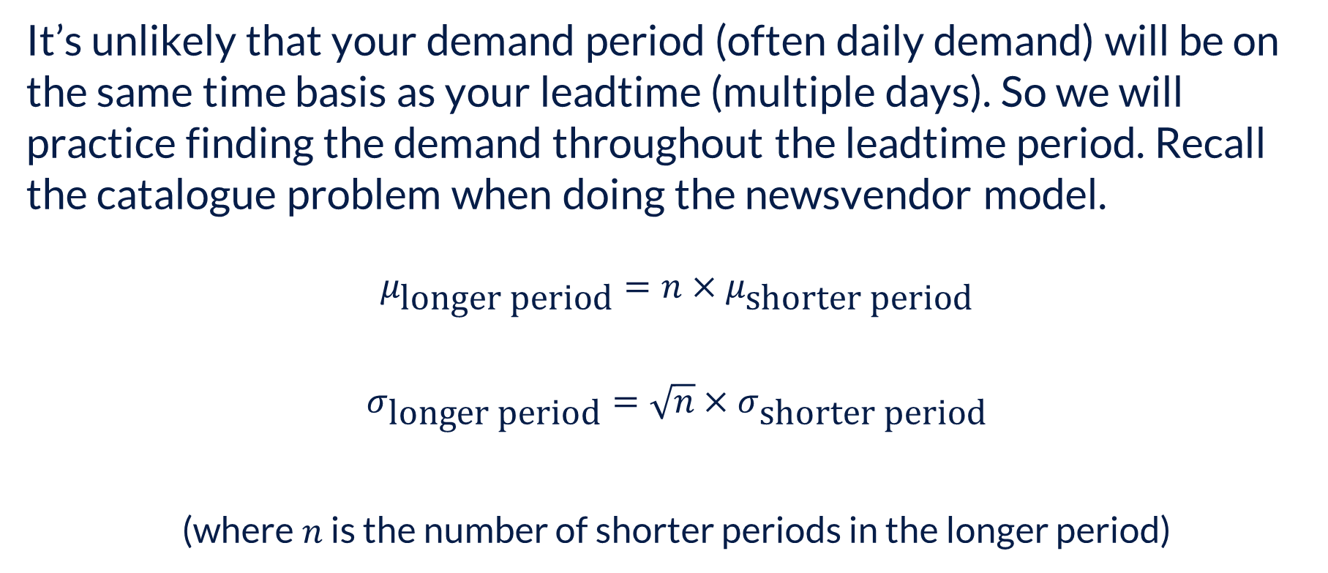
Order-Up-To Model – Trick-er-oo #2
It’s unlikely that your demand period (often daily demand) will be on the same time basis as your leadtime (multiple days). So we will practice finding the demand throughout the leadtime period. Recall the catalogue problem when doing the newsvendor model.
$$μ_{\text{l}\text{onger} \text{period}}=n×μ_{\text{shorter} \text{period}}$$
$$σ_{\text{longer} \text{period}}=\sqrt{n}×σ_{\text{shorter} \text{period}}$$
(where $n$ is the number of shorter periods in the longer period)

Slide 27
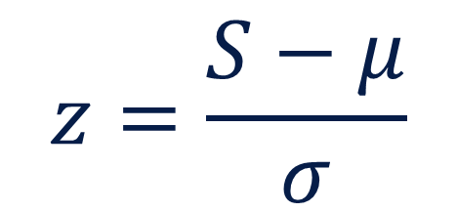
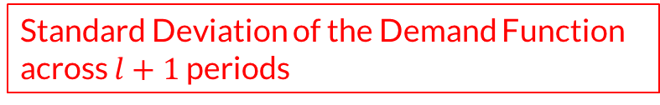
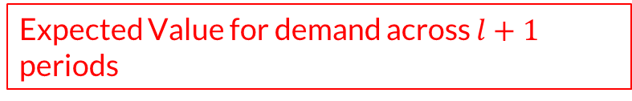
Order-Up-To Model
Stock-out Probability
Expected Value for demand across $l+1$ periods
$$z=\frac{S−μ}{σ}$$
Standard Deviation of the Demand Function across $l+1$ periods

Slide 28
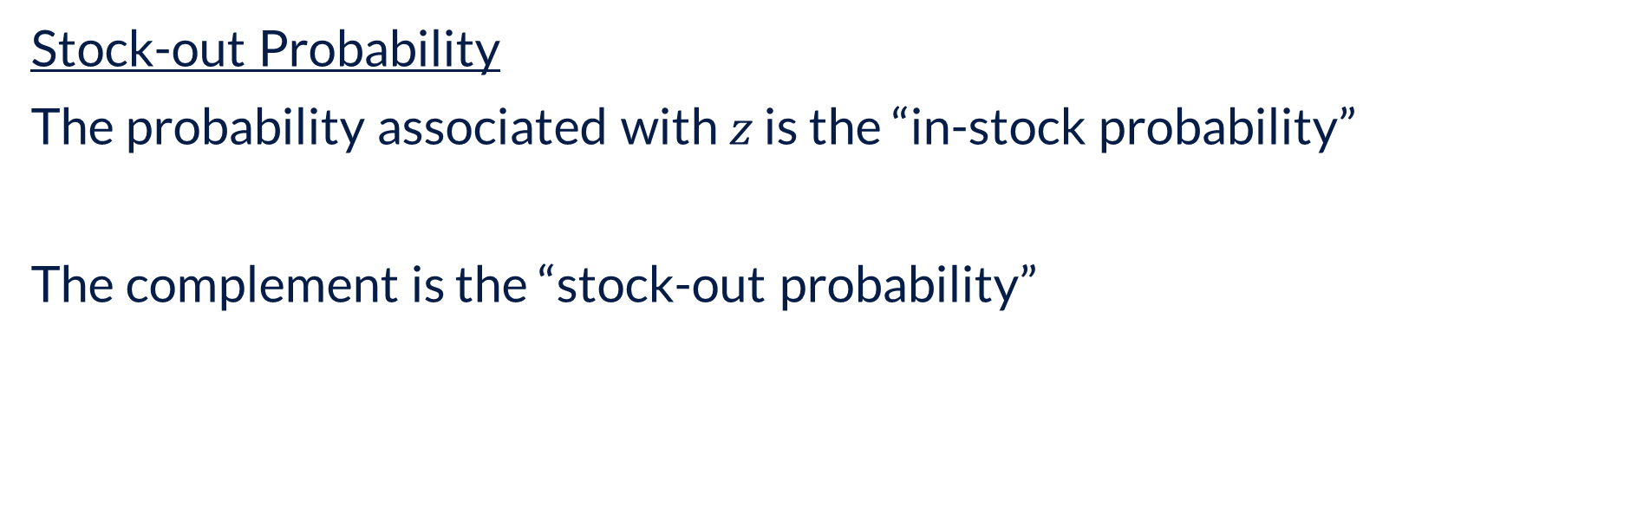
Order-Up-To Model
Stock-out Probability
The probability associated with $z$ is the “in-stock probability”
The complement is the “stock-out probability”

Slide 29
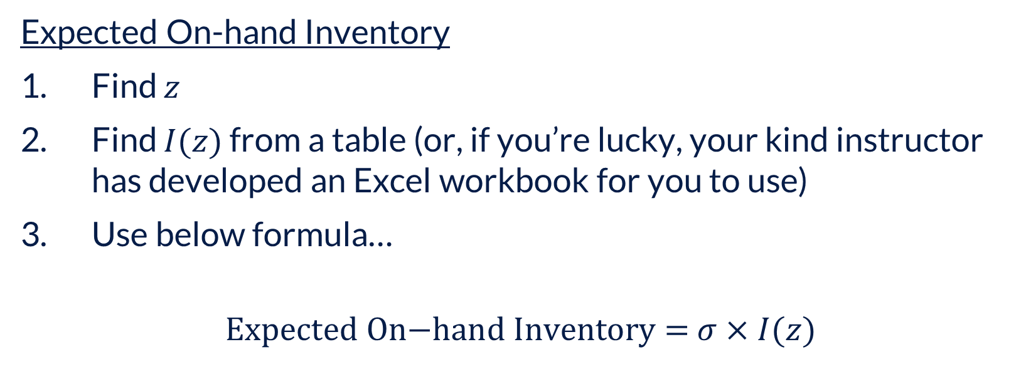
Order-Up-To Model
Expected On-hand Inventory
Find $z$
Find $I(z)$ from a table (or, if you’re lucky, your kind instructor has developed an Excel workbook for you to use)
Use below formula…
$$\text{Expected} \text{On}\text{−}\text{hand} \text{Inventory}\text{ = }σ×I(z)$$

Slide 30
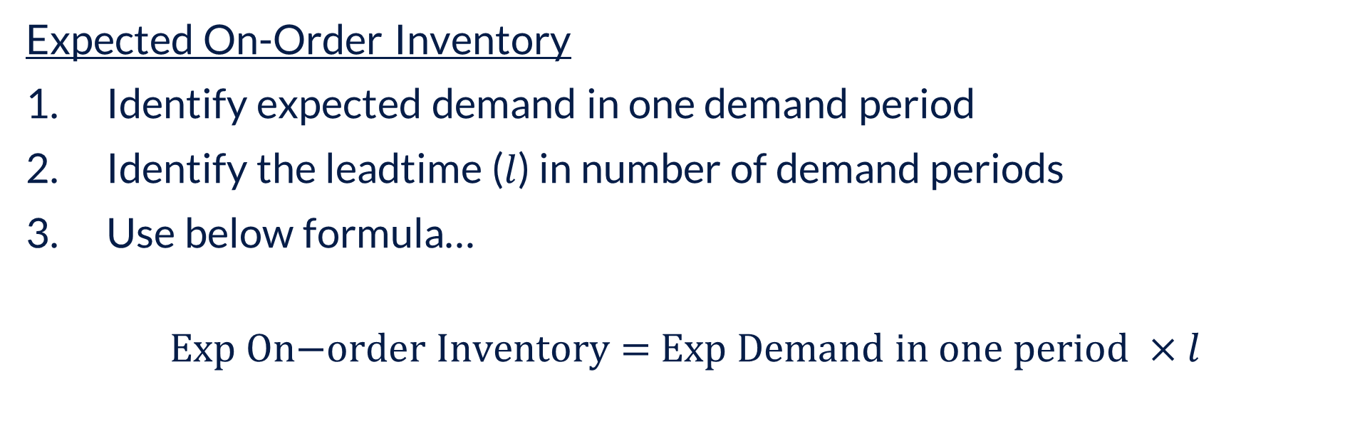
Order-Up-To Model
Expected On-Order Inventory
Identify expected demand in one demand period
Identify the leadtime ($l$) in number of demand periods
Use below formula…
$$\text{Exp} \text{On}\text{−}\text{order} \text{Inventory}\text{ = }\text{Exp} \text{Demand} \text{in} \text{one} \text{period} ×l$$
Expected on-order inventory is often called the “Pipeline Inventory”

Slide 31
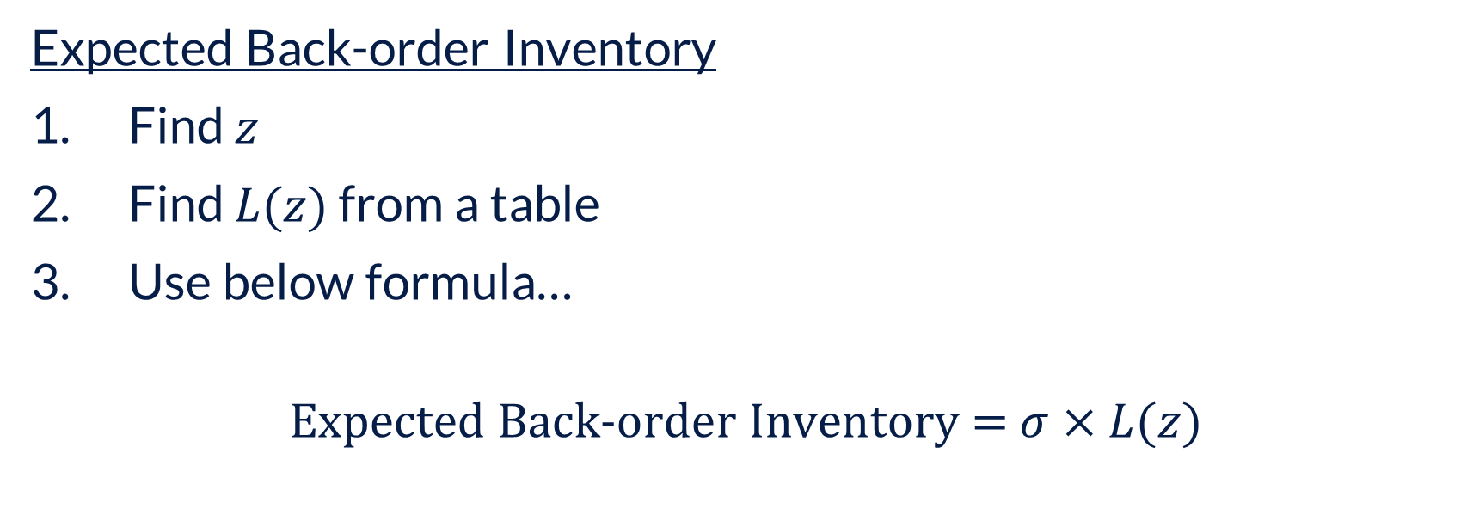
Order-Up-To Model
Expected Back-order Inventory
Find $z$
Find $L(z)$ from a table
Use below formula…
$$\text{Expected} \text{Back}\text{-}\text{order} \text{Inventory}\text{ = }σ×L(z)$$

Slide 32
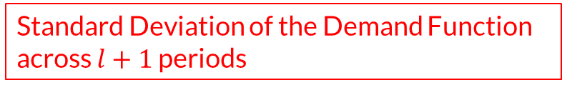
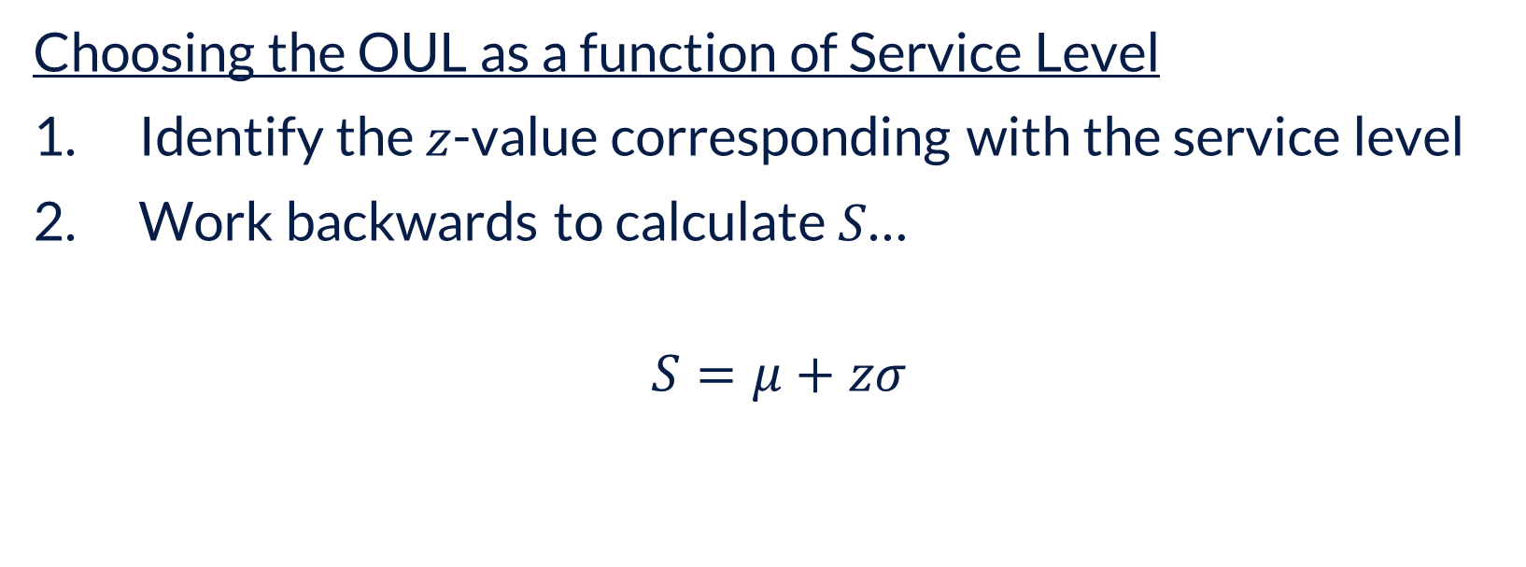
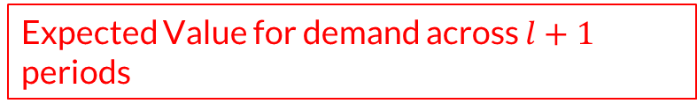
Order-Up-To Model
Choosing the OUL as a function of Service Level
Identify the $z$-value corresponding with the service level
Work backwards to calculate $S$…
$$S=μ+zσ$$
Expected Value for demand across $l+1$ periods
Standard Deviation of the Demand Function across $l+1$ periods

Slide 33
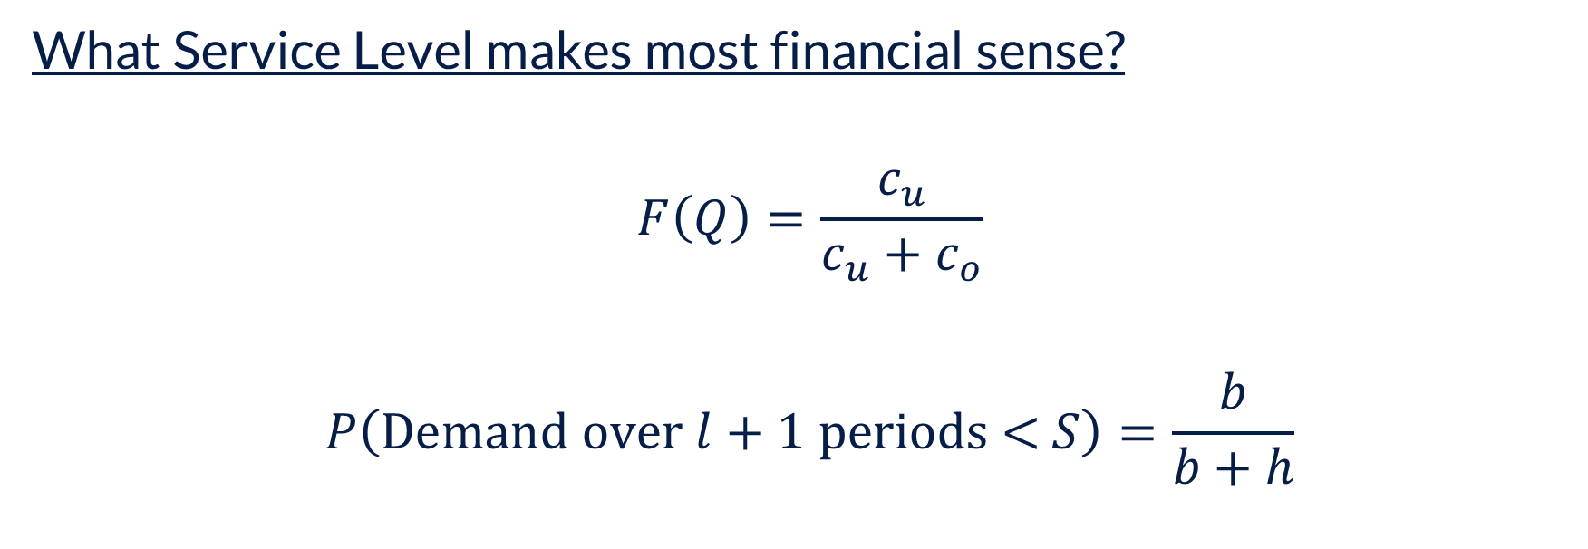
Order-Up-To Model
What Service Level makes most financial sense?
$$F\left(Q\right)=\frac{c_{u}}{c_{u}+c_{o}}$$
$$P\left(\text{Demand} \text{over} l+1 \text{periods}\text{ < }S\right)=\frac{b}{b+h}$$

Slide 34
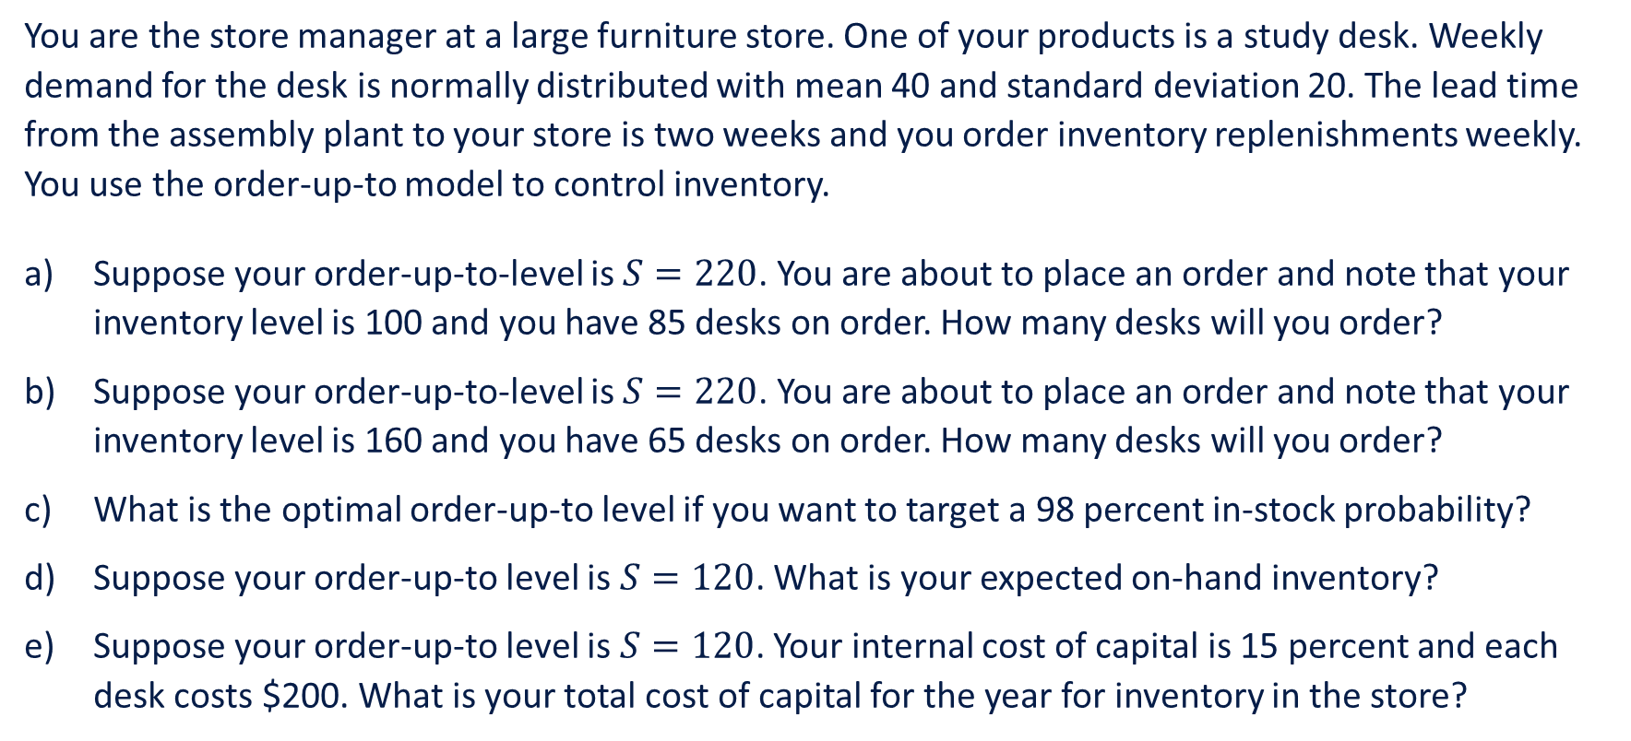
Example
You are the store manager at a large furniture store. One of your products is a study desk. Weekly demand for the desk is normally distributed with mean 40 and standard deviation 20. The lead time from the assembly plant to your store is two weeks and you order inventory replenishments weekly. You use the order-up-to model to control inventory.
Suppose your order-up-to-level is $S=220$. You are about to place an order and note that your inventory level is 100 and you have 85 desks on order. How many desks will you order?
Suppose your order-up-to-level is $S=220$. You are about to place an order and note that your inventory level is 160 and you have 65 desks on order. How many desks will you order?
What is the optimal order-up-to level if you want to target a 98 percent in-stock probability?
Suppose your order-up-to level is $S=120$. What is your expected on-hand inventory?
Suppose your order-up-to level is $S=120$. Your internal cost of capital is 15 percent and each desk costs $200. What is your total cost of capital for the year for inventory in the store?

Slide 35
Example

Slide 36
Example

Slide 37
The Beer Game – Take 2

Slide 38
The Beer Game – Take 2
Step 1: Click the button labelled “Join New Game Session”
Step 3: Use the code 62q1

